Slide 1

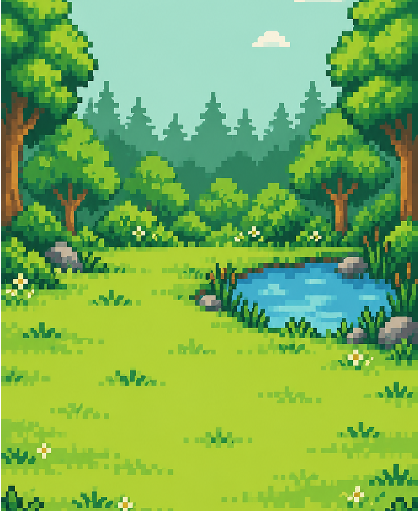
Recycli
Gamifying Sustainability for a Greener Future
PROJECT TEAM
Farden Khan • Jintian Wu
Colin Bond-Burt • Christopher Wiratman

Slide 2
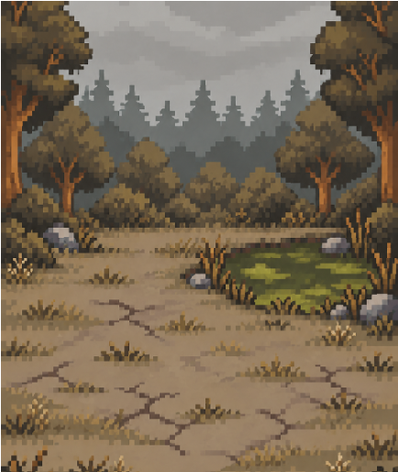
HACKATHON SUBMISSION
CodeRED: Orion
TARGET TRACK
Best Environment Hack
Dedicated to projects that directly champion environmental sustainability, resource conservation, and eco-friendly technology.

Slide 3
ENVIRONMENTAL SUSTAINABILITY & SMART CITIES
The Challenges We Combat
Core Challenge
Municipalities struggle to enforce proper recycling habits at the consumer level, leading to highly contaminated waste streams and inefficient processing.
9%
Of all plastic waste ever produced has been recycled.
79%
Of plastic waste accumulates in landfills or the natural environment.
$ Millions
Lost annually by municipalities due to single-stream bin cross-contamination.
Our Objective
Develop an interactive, accessible mobile application that leverages behavioral psychology and gamification to educate users and incentivize accurate, daily recycling habits.

Slide 4
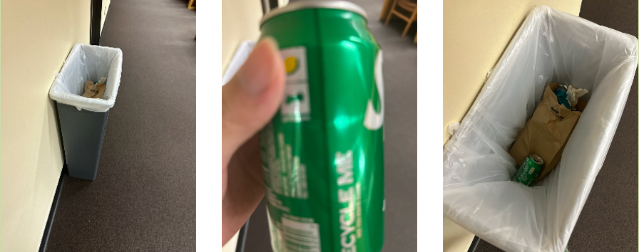
HOW RECYCLI WORKS
Recycli Rewards Real-World Action
with Digital Progression
1. Scan & Learn
Users scan their waste items using their smartphone camera. The app identifies the material and provides local disposal instructions.
2. Earn Points
Correctly logging and disposing of items rewards users with 'Leaves'.
3. Gamified Environment
Users build and upgrade a digital 'Virtual Garden' that flourishes as they recycle more in the real world.
BIN
Smart location & setup
ITEM
Material identification
DISPOSAL
Verified action log

Slide 5
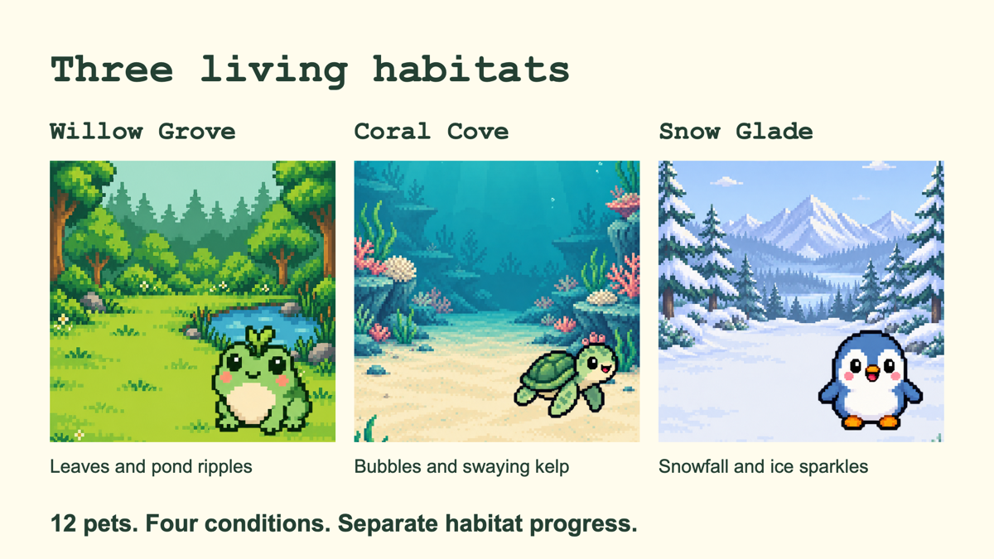

Slide 6
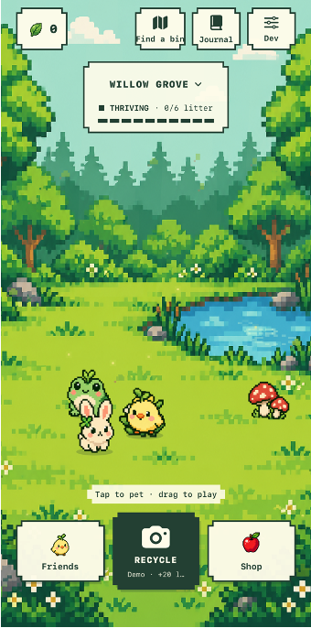
DEMO WALKTHROUGH
Recycli in Action
Instead of just telling, lets go ahead and show!

Slide 7
SYSTEM ARCHITECTURE
EcoGotchi’s iPhone Architecture
SWIFTUI
AVFOUNDATION
LOCAL STORAGE
GEMINI API
ON IPHONE
Native app
SwiftUI powers the habitats and pet interactions. AVFoundation captures the bin and item photos.
GAME & DATA
Local progress
HabitatStore manages leaves and rewards. UserDefaults saves progress and review receipts. Keychain stores the API key.
CLOUD REVIEW
Gemini AI
The iPhone sends both photos to Gemini over HTTPS. Likely recycling matches earn leaves based on material. Review continues while you play.
Demo accepts scans offline. Actual reviews photos with Gemini. No Mac connection required.

Slide 8
MARKET IMPACT & ROADMAP
Expanding Impact Through Partnerships and Smart Hardware
Market Impact & Environmental Strategy
Effortless & Efficient Recycling: Streamlines sorting and disposal through gamification, making sustainable habits seamless and easy to do for users..
Habitat & Biodiversity Protection: Reduces litter and contamination in local ecosystems, lowering pollution levels to protect natural wildlife habitats.
Targeted Rollout: Focuses initial deployment on university campuses and eco-conscious municipalities to maximize immediate ecological footprint reduction.
Future Roadmap
PHASE 1
Launch beta application and refine object recognition model.
PHASE 2
Partner with local sustainable brands for real-world discounts.
PHASE 3
Integrate with IoT smart bins to automatically verify disposal.
PHASE 4
Photograph local wildlife to 'collect' animals and grow your digital ecosystem.

